Slide 1

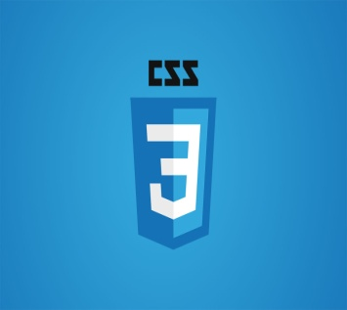
Front end
(Introduction to css)
Lecture-20

Slide 2
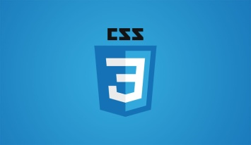
Today’s Agenda
Positioning In CSS
Various Types Of Positioning In CSS
Other Properties Used With Positioning

Slide 3
CSS Positioning
Using CSS, we can set all the elements on our webpage to any position we like.
For example, we can position an element at the very top of our page, or 50px below the element before it.

Slide 4
CSS Positioning
To control just how an element will appear in the layout, we need to use the position property in CSS.
In addition, we can utilize some other position-related properties: top, right, bottom, left, and z-index.

Slide 5
Possible Values Of Position
The position property can take five different values and they are:
static
relative
absolute
fixed
sticky

Slide 6
Static Positioning
A static positioned element is always positioned according to the normal flow of the page.
All the HTML elements are positioned as static by default.
Static positioned elements are not affected by the top, bottom, left, right, and z-index properties.

Slide 7
Example
.one
{
position: static;
top: 50px;
}
The above rule set will have no effect since the position property is set to static which remains unaffected with any kind of positioning.

Slide 8
Relative Positioning
A relative positioned element is positioned with respect to its normal position.
In the relative positioning scheme the element's box position is calculated according to the normal flow.
Then the box is shifted from this normal position according to the properties — top or bottom and/or left or right.

Slide 9
Example
.one
{
position: relative;
top: 50px;
}
The above rule set will have shift the element to 50px downwards from its original position

Slide 10
Points To Remember About Relative Positioning
A relatively positioned element can be moved out from its original position but it keeps the space originally reserved for it in the normal flow.
It can overlap with other elements according to their order of appearance in the page and to prioritize this overlapping , we can use another property called z-index

Slide 11
The z-index Property
The z-index property in CSS controls the vertical stacking order of elements that overlap.
As in, which one appears closer to the user.
z-index only affects elements that have a position value other than static

Slide 12
What If We Don’t Use z-index ?
Without any z-index value, the elements will always stack in the order that they appear in the page .
That is ,the lowest one down at the same hierarchy level appears on top.

Slide 13
What If We Don’t Use z-index ?
However we can change it by setting the z-index , which has a simple rule that an element with greater z-index value is always in front of an element with a lower z-index value.
Example:
div
{
position: relative;
top: 50px;
z-index: 1;
}

Slide 14
Absolute Positioning
An element with position: absolute is positioned at the specified coordinates.
It is taken out of the normal flow and can be placed absolutely anywhere on the web page that the designer chooses.

Slide 15
Example
.one
{
position: absolute;
top: 50px;
}
The above rule set will have set the element to 50px downwards from top.

Slide 16
An Important Point!
An absolutely positioned element is positioned relative to the first parent element that has a position other than static.
If no such element is found, it will be positioned on a page relative to the 'top-left' corner of the browser window

Slide 17
Fixed Positioning
Fixed positioning allows us to fix the position of an element to a particular spot on the page, regardless of scrolling.
In other words , we can say that the fixed positioning is a subcategory of absolute positioning.
The only difference is, a fixed positioned element is fixed with respect to the browser's viewport and does not move when scrolled.

Slide 18
Example
.one
{
position: fixed;
top: 50px;
left: 100px;
}
The above rule set will have set the element to 50px downwards from top and 100px towards right. Moreover the position of the element will not change when the page is scrolled.

Slide 19
Sticky Positioning
A position: sticky element will initially behave like position: relative element, but if we keep scrolling, they will get taken out of the normal flow and behave like position: fixed wherever we have positioned them.
In simple words , we can say that a sticky element toggles between relative and fixed, depending on the scroll position.

Slide 20
Example
.another
{
position: sticky;
top: 0px;
}
The above rule set will have initially let the element scroll until it reaches the top at 0px , then the element will become fixed at that position will not further scroll with the page.

Slide 21
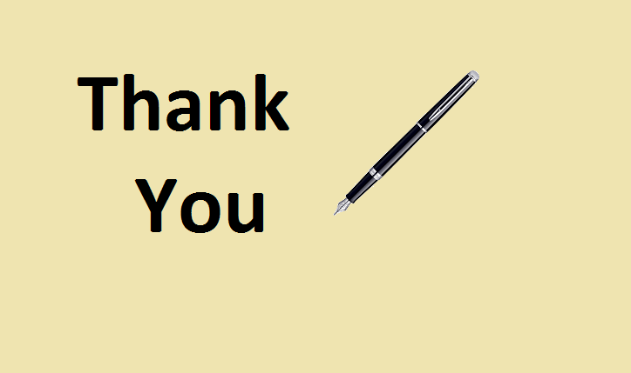
End Of Lecture
For any queries mail us @: scalive4u@gmail.com
Call us @ : 0755-4271659, 9826686245
Agenda for Next Lecture:
Introduction To Java Script

